Slide 1
MULTIPLE BREAK REBAR
Advisor : Prof. K.C.Chang
Presenters : You-Ran Nai

Slide 2
Incremental Dynamic Analysis with Multi-Modes for Seismic Performance Evaluation of RC Bridges
Prakit Chomchuen, Virote Boonyapinyo
Engineering Structures
February 2017

Slide 3
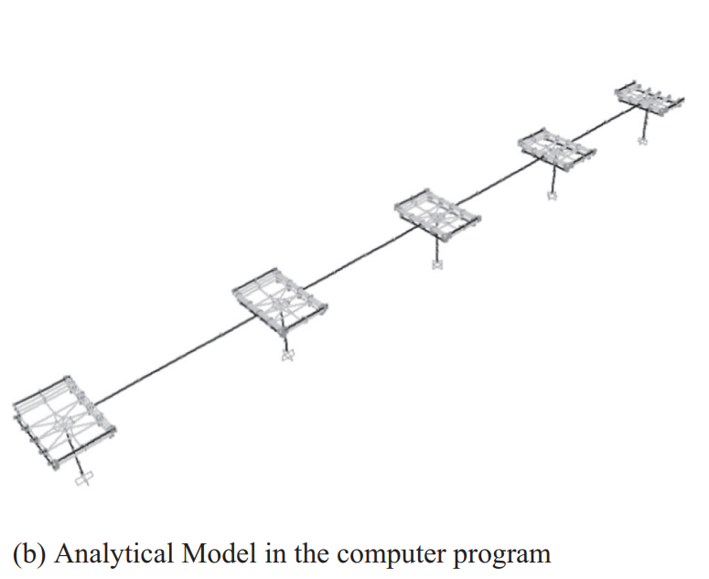
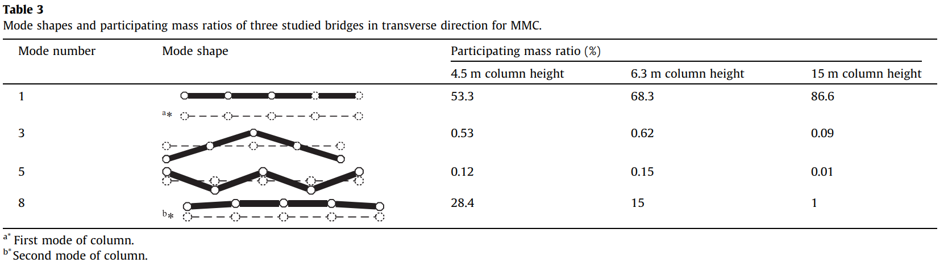
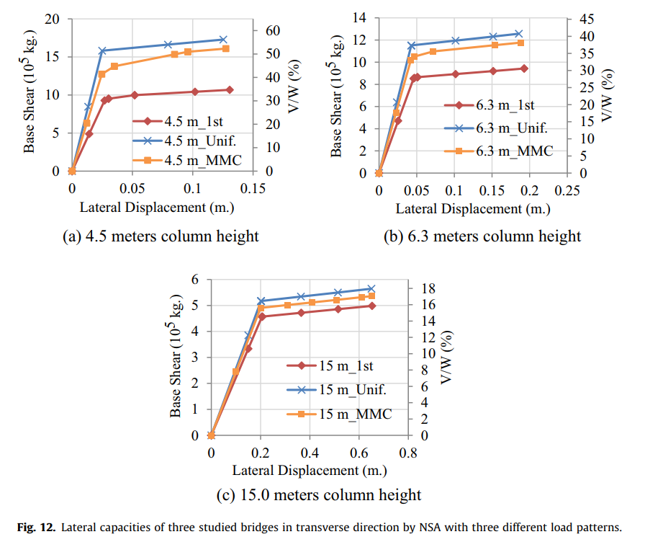
WHY ONE YIELDING OCCUR?
5 COLUMNS
SAME HEIGHT
5 COLUMNS
SIMULTANEOUSLY YIELDING
ONE YIELDING

Slide 4
Incremental dynamic analysis
Dimitrios Vamvatsikos and C. Allin Cornell
EARTHQUAKE ENGINEERING AND STRUCTURAL DYNAMICS
2002
Notes:
Department of Civil and Environmental Engineering; Stanford University; CA 94305-4020; U.S.A.

Slide 5




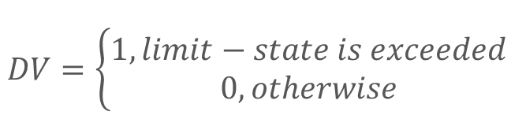

PBEE FRAMEWORK
$$DV=\left\{\begin{aligned}1, limit−state is exceeded \\ 0, otherwise\end{aligned}\right.$$
$$λ\left(IM\right): hazard curve$$
$$G\left(DM | IM\right):(conditional) complementary cumulative distribution$$

Slide 6
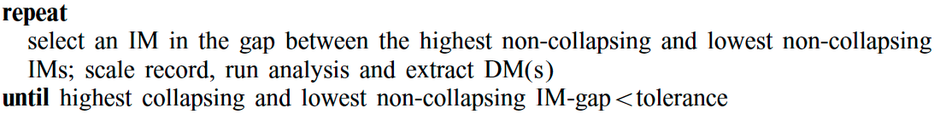
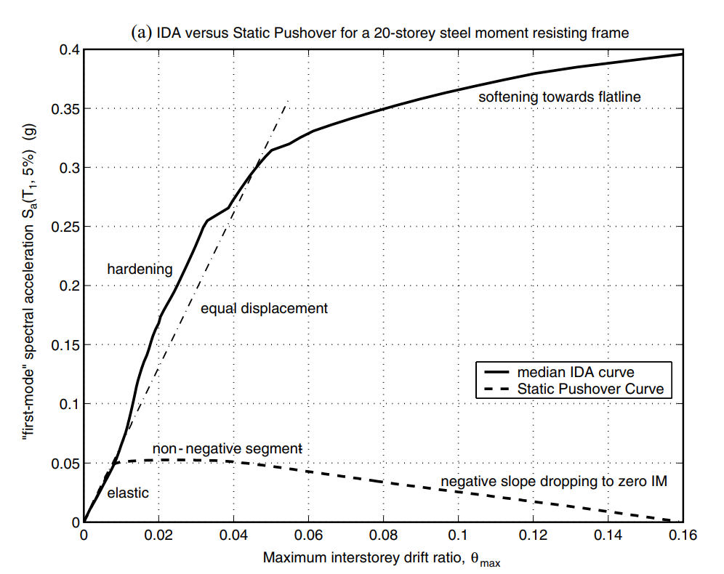
FILL PHASE –
CAPACITY RESOLUTION

Slide 7
Furthermore, to improve upon the capacity resolution, a simple enhancement is to add a step-reducing routine, for example bisection, when collapse (e.g. non-convergence) is detected, so as to tighten the bracketing of the flatline.
FILL PHASE –
CAPACITY RESOLUTION

Slide 8
LINEAR - FROM EXISTING REBAR
1
2
3
4
5
MOMENT DIAGRAM
TENSION DEVELOPMENT LENGTH
GRAVITY DEMAND
LOAD PATTERN
REDUCE TO THREE / FOUR POINTS
Notes:
- 推估的演算法是用彎矩圖，上層筋以地震力，下層筋以重力與地震力進行多點斷筋。
- 並加上精算法的延伸長度。
- 手動輸入 Gravity 需求。(忽略帶寬、不平均)
- 手動輸入 Gravity 負彎矩偏差比例。Load Pattern Fix fix , fix pin , pin-fix , pin-pin
- 由無限斷筋縮減到有限點斷筋(3 點或 4 點) - 排列組合、分群演算法。

Slide 9
REDUCE TO THREE POINTS
BEFORE
AFTER
FINITE PERMUTATION
0.15~0.4
AVOID EXTREME SITUATION
0.15~0.4
0.6~0.85
Notes:
換圖案

Slide 10
OUTLINE
1
2
3
4
FROM EXISTING REBAR (WITHOUT ETABS)
ETABS/SAP DEMAND
MULTI-MODES PUSHOVER
NONLINEAR TIME HISTORY ANALYSIS

Slide 11
PRECONDITION
LATERAL FORCE(EARTHQUAKE OR WIND)
GRAVITY LOAD(DEAD LIVE)
GIRDER
EARTHQUAKE VERTICAL FORCE
LATERAL EARTH PRESSURE, GROUND WATER PRESSURE, OR PRESSURE OF BULK MATERIALS

Slide 12
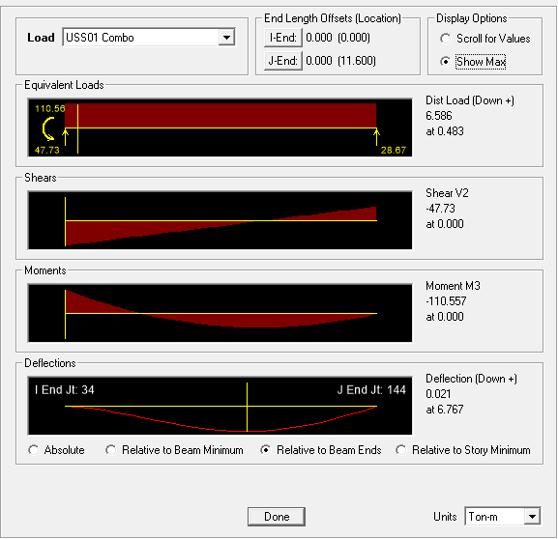

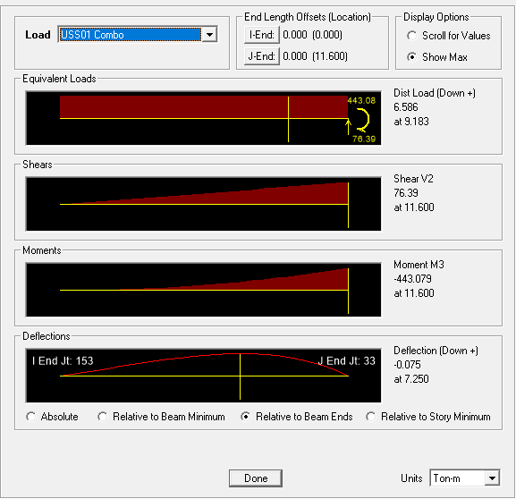

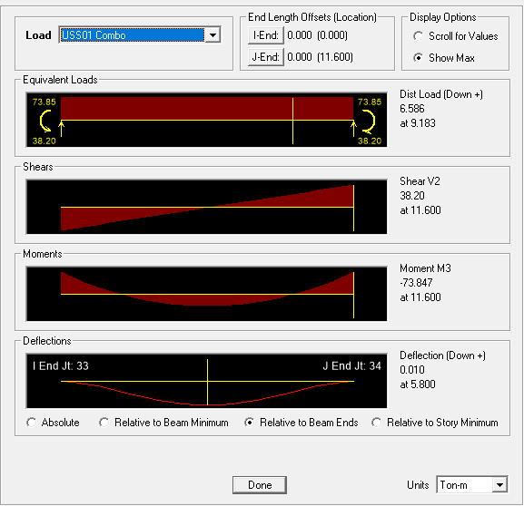

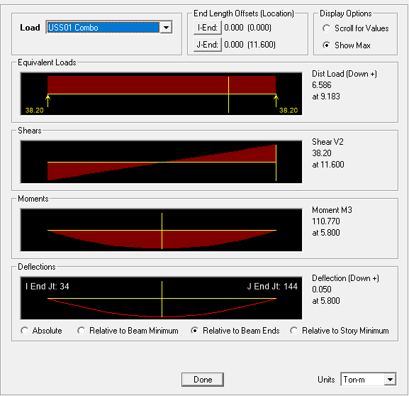

PRECONDITION
FIX-PIN
BOUNDARY CONDITION
FIX-FIX
FIX-FREE
PIN-PIN

Slide 13
ALGORITHM
INITIAL TOP REBAR

Slide 14
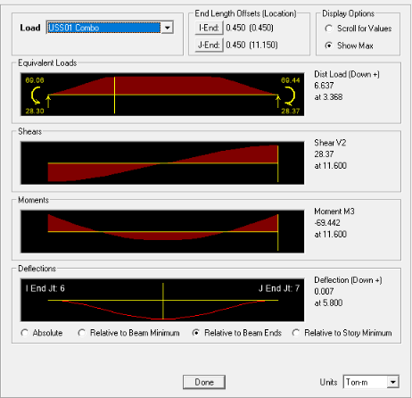
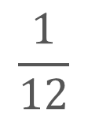
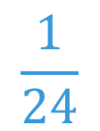
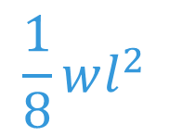
(SDL + SLAB) LL
BAND SPAN
$$\frac{1}{8}wl^{2}$$
➔
(1) U=1.4D
(2) U=1.2D + 1.6L
(3) U=1.2D + (1.0L or 0.5L)
(4) U=1.2D + 1.6W + (1.0L or 0.5L)
(5) U=1.2D + 1.0E + (1.0L or 0.5L)
(6) U=0.9D + 1.6W
(7) U=0.9D + 1.0E
50%
$$\frac{1}{12}$$
$$\frac{1}{24}$$
➔
➔
0.9D
IMPROVE: BIG DATA
SPAN STORY
0.9 * Mn = 0.9 * As * Fy * 0.9d >= Mu
94%

Slide 15
ALGORITHM
(1) U=1.4D
(2) U=1.2D + 1.6L
(3) U=1.2D + (1.0L or 0.5L)
(4) U=1.2D + 1.6W + (1.0L or 0.5L)
(5) U=1.2D + 1.0E + (1.0L or 0.5L)
(6) U=0.9D + 1.6W
(7) U=0.9D + 1.0E
LATERAL
FORCE
GRAVITY LOAD

Slide 16
ALGORITHM
(1) U=1.4D
(2) U=1.2D + 1.6L
(3) U=1.2D + (1.0L or 0.5L)
(4) U=1.2D + 1.6W + (1.0L or 0.5L)
(5) U=1.2D + 1.0E + (1.0L or 0.5L)
(6) U=0.9D + 1.6W
(7) U=0.9D + 1.0E
LATERAL
FORCE
GRAVITY LOAD

Slide 17
ALGORITHM
CHANGE TO
REBAR NUMBER
LINEAR ADD

Slide 18
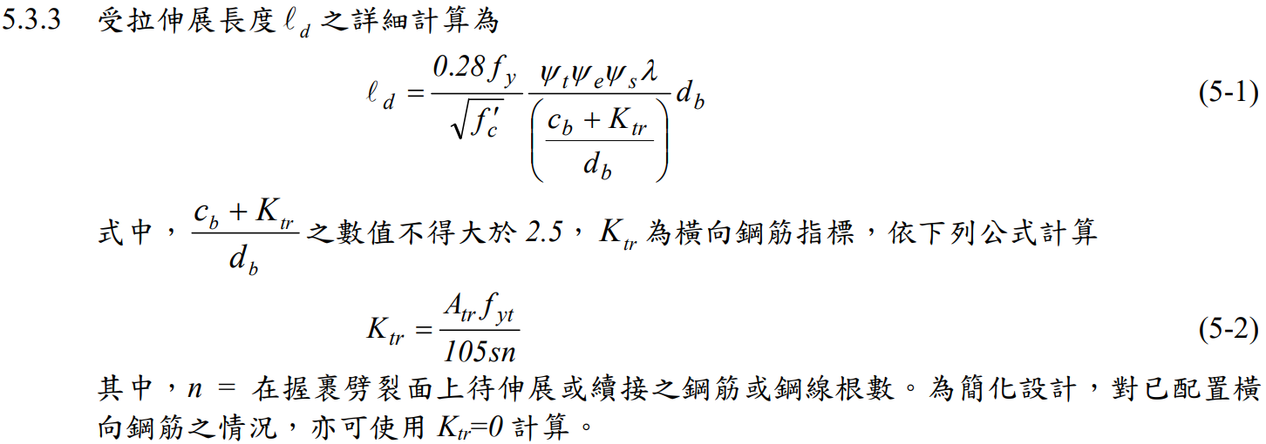
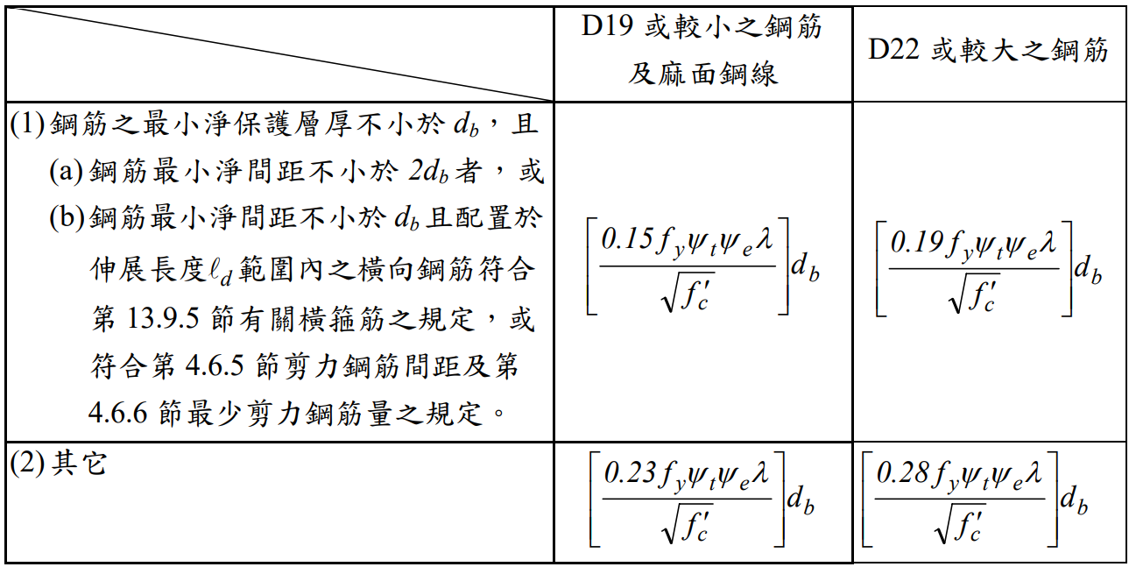
GENERAL DEVELOPMENT LENGTH EQUATION
DEVELOPMENT LENGTH
MIN
➔
SIMPLIFIED PROVISIONS
Beam width, cover, Fy, Fyt, Fc’,
Rebar‘s Db, Stirrup’s Db,
Spacing, rebar number

Slide 19
ALGORITHM
BEFORE
REDUCE TO THREE POINTS
AFTER
FINITE PERMUTATION
0.15~0.4
AVOID EXTREME SITUATION
IMPROVE: REDUCE PERMUTATION
0.15~0.4
0.6~0.85

Slide 20
ALGORITHM
INITIAL BOT REBAR

Slide 21
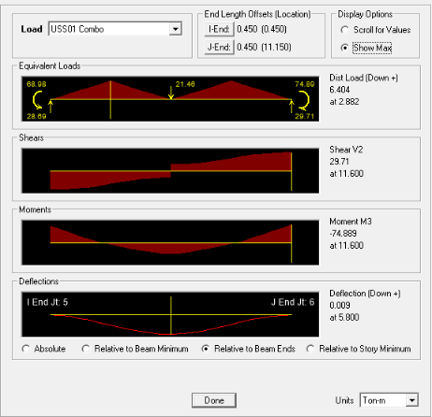
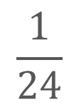
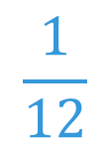

(SDL + SLAB) LL
BAND SPAN
$$\frac{1}{8}wl^{2}$$
➔
(1) U=1.4D
(2) U=1.2D + 1.6L
(3) U=1.2D + (1.0L or 0.5L)
(4) U=1.2D + 1.6W + (1.0L or 0.5L)
(5) U=1.2D + 1.0E + (1.0L or 0.5L)
(6) U=0.9D + 1.6W
(7) U=0.9D + 1.0E
50%
$$\frac{1}{24}$$
$$\frac{1}{12}$$
➔
➔
1.2D + 1.6L
IMPROVE: BIG DATA
SPAN STORY
0.9 * Mn = 0.9 * As * Fy * 0.9d >= Mu
119%
Notes:
Span 較短

Slide 22
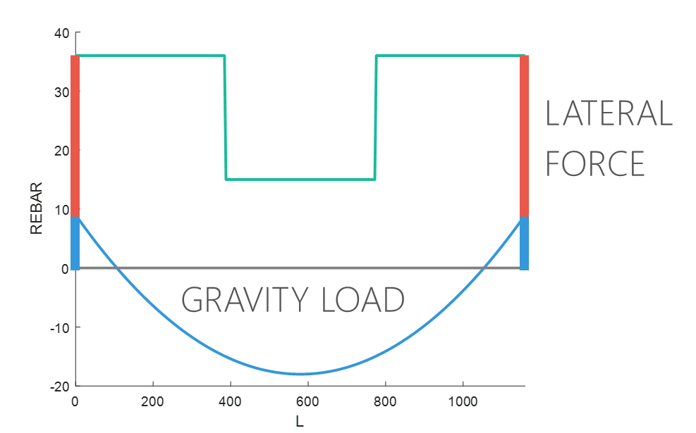
ALGORITHM
DIFFERENT FROM TOP
(1) U=1.4D
(2) U=1.2D + 1.6L
(3) U=1.2D + (1.0L or 0.5L)
(4) U=1.2D + 1.6W + (1.0L or 0.5L)
(5) U=1.2D + 1.0E + (1.0L or 0.5L)
(6) U=0.9D + 1.6W
(7) U=0.9D + 1.0E
GRAVITY LOAD
LATERAL
FORCE

Slide 23
ALGORITHM
CHANGE TO
REBAR NUMBER
LINEAR ADD

Slide 24
GENERAL DEVELOPMENT LENGTH EQUATION
DEVELOPMENT LENGTH
MIN
➔
SIMPLIFIED PROVISIONS
Beam width, cover, Fy, Fyt, Fc’,
Rebar‘s Db, Stirrup’s Db,
Spacing, rebar number

Slide 25
ALGORITHM
REDUCE TO THREE POINTS
FINITE PERMUTATION
0.15~0.4
AFTER
AVOID EXTREME SITUATION
BEFORE
IMPROVE: REDUCE PERMUTATION
0.15~0.4
0.6~0.85

Slide 26
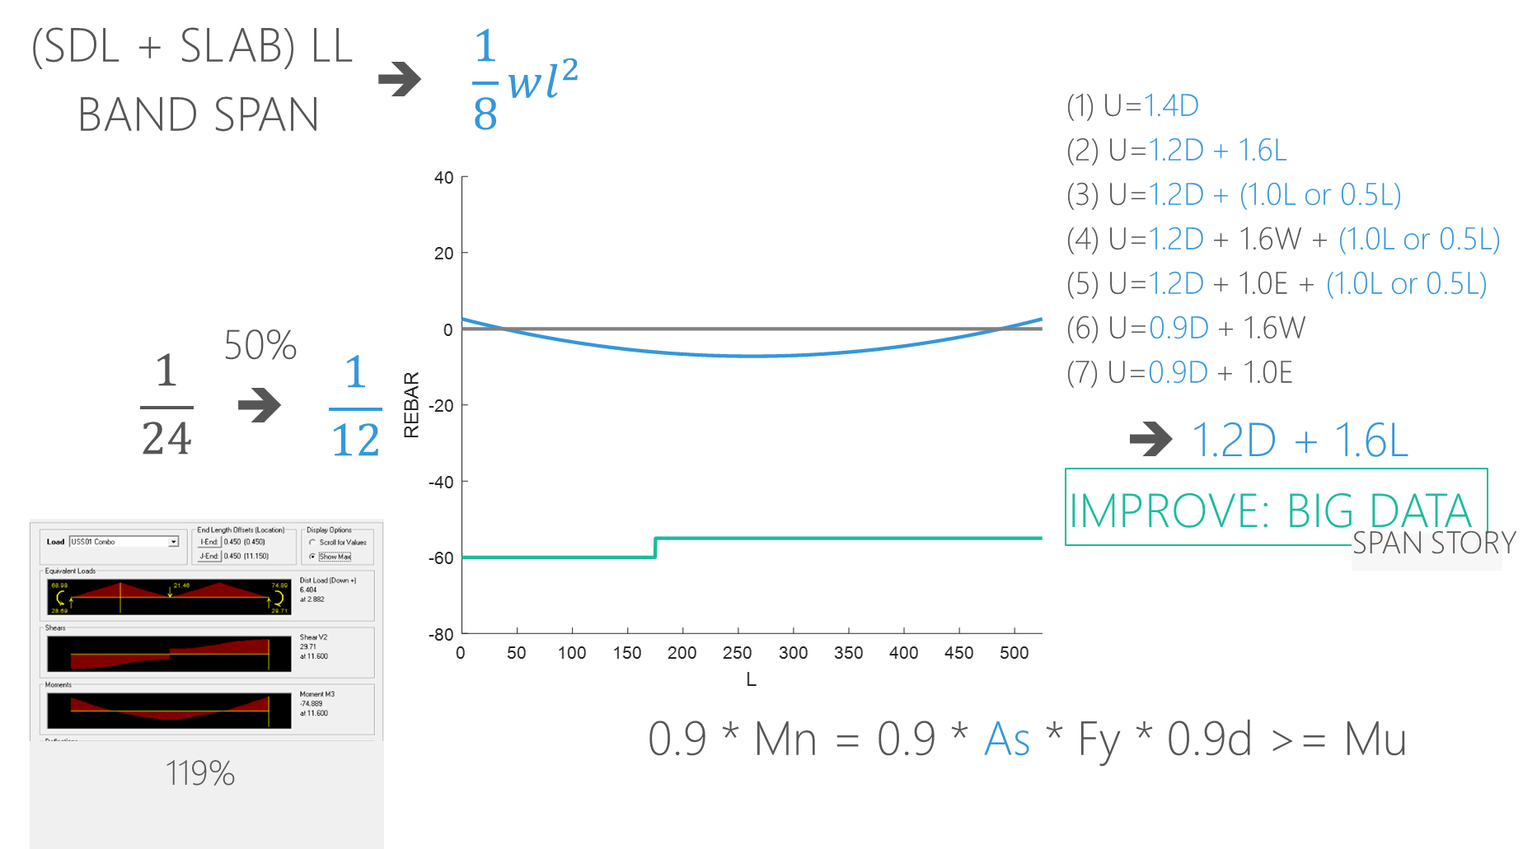
OTHER CASE
MORE THAN INITIAL REBAR
UNREASONABLE
➔
➔

Slide 27
OTHER CASE
MAX
➔
MAX
MAX
1/3
2/3
1/4
3/4
1/4
3/4

Slide 28
GENERAL DEVELOPMENT LENGTH EQUATION
DEVELOPMENT LENGTH
MIN
➔
SIMPLIFIED PROVISIONS
Beam width, cover, Fy, Fyt, Fc’,
Rebar‘s Db, Stirrup’s Db,
Spacing, rebar number

Slide 29
BEFORE
=
AFTER
+
IMPROVE: CONSTRUCTION COST ASSESSMENT

Slide 30
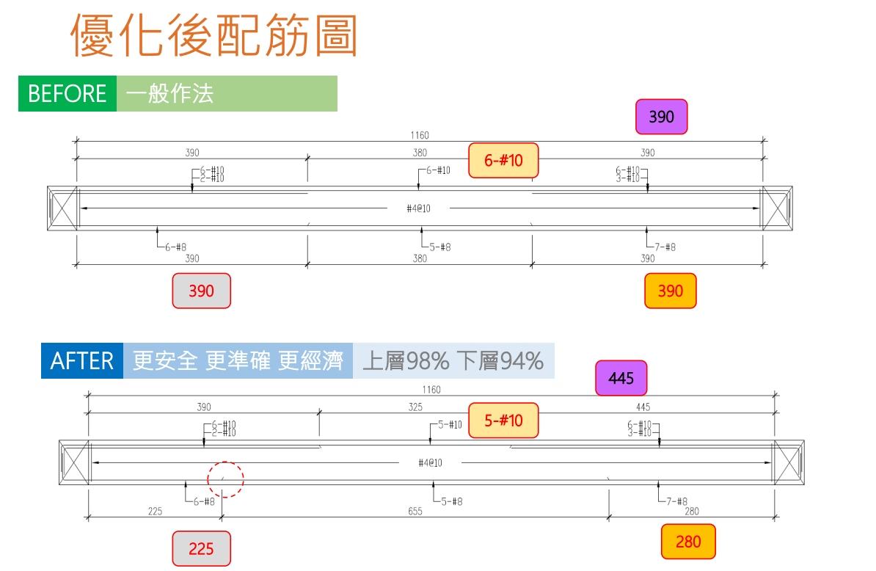

Slide 31
91.8%
95.5%
98.2%
62.4%
75.9%

Slide 32
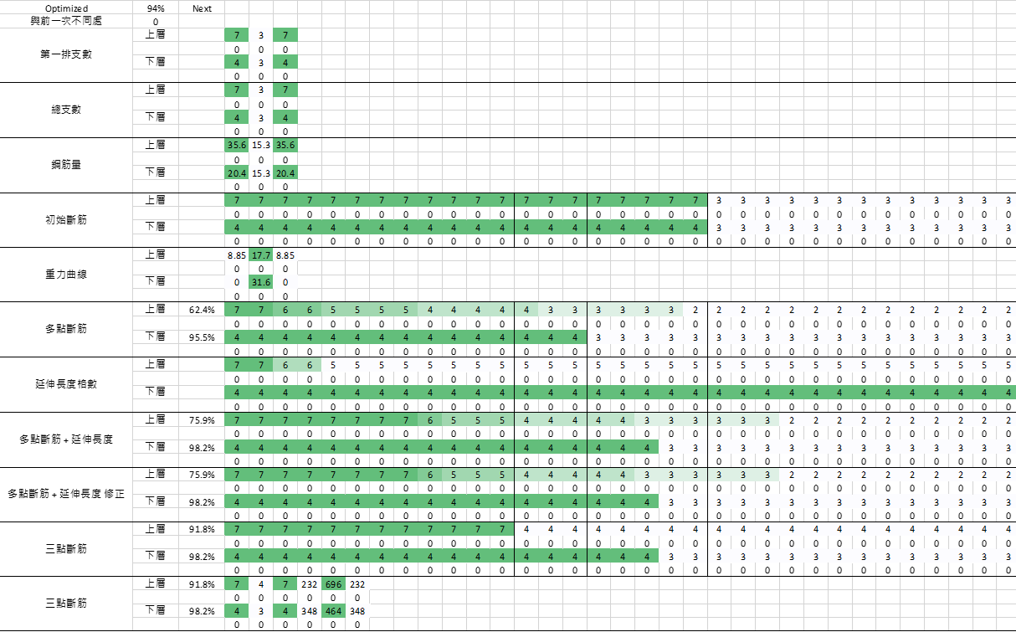

Slide 33
Roadmap
NEXT
NEXT
2019
ETABS/SAP DEMAND
IMPROVE STABILITY AND PERFORMANCE
NONLINEAR TIME HISTORY ANALYSIS
DONE
NEXT
12/2018
REDUCE TO THREE / FOUR POINTS
BIG DATA
MULTI-MODES PUSHOVER

Slide 34
Punchline of your project in a few words
Here is the subline, explain your project in 2-3 lines so that we clearly understand the value proposal.

Slide 35
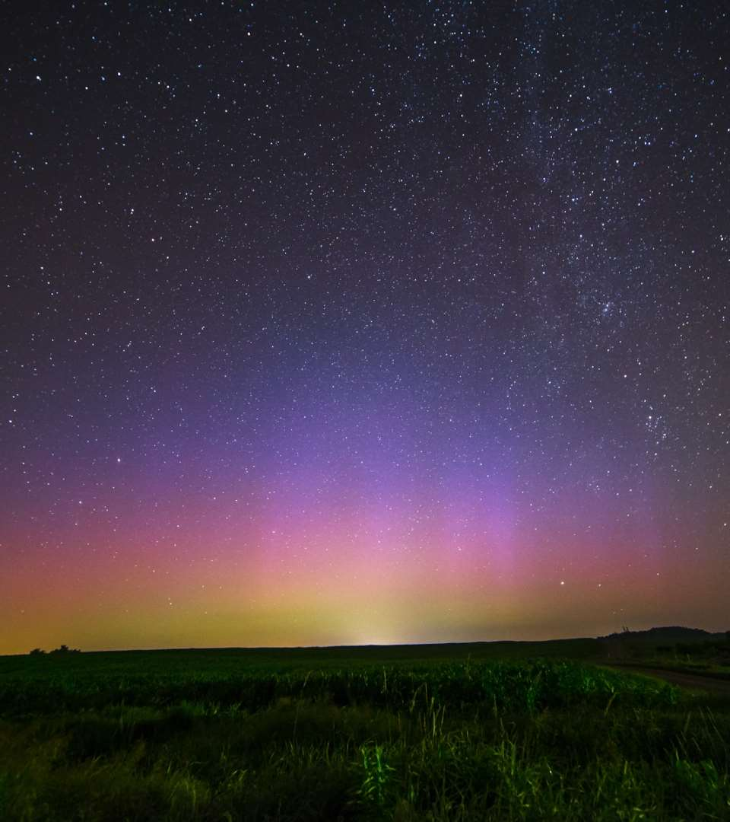
The problem you want to solve

Slide 36
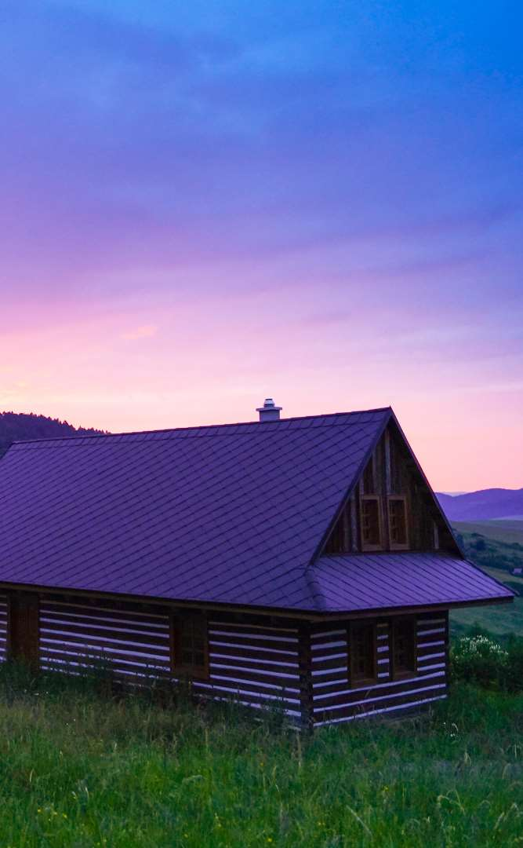


Today’s solutions

Slide 37
Why it doesn’t work
Difficult to implement
Expensive for small businesses
Zero customization

Slide 38

Your solution

Slide 40
Your solution

Slide 41
Your solution

Slide 42
Your solution

Slide 44
Your solution

Slide 45
Awesome features
Awesome map feature
Awesome like feature
Awesome battery feature

Slide 46
Use case
1
2
3
4
5
Very Easy Step 1
Very Easy Step 2
Very Easy Step 3
Very Easy Step 4
Very Easy Step 5

Slide 47
Value Proposal
Make things really change
Make the world a better place
Offer one perfect answer
This is how we are going to make this happen in a beautiful way.
This is how we are going to make this happen in a beautiful way.
This is how we are going to make this happen in a beautiful way.

Slide 48
Market Sizing
$36b
$12b
$2b
Total World Market
Total US Market
Total FR Market
Source : source.io
Source : source.io
Source : source.io

Slide 49
Market Size over Time
Market Sizing (in €billions)

Slide 50
Market on Map
$1b
$2b

Slide 51
Why Now ?
Mobile Internet Usage

Slide 52


Customer Profiles
Young adults
25-35 years old
Students
15-20 years old

Slide 53
Competitors

Slide 54
AXIS 2
Your company
competitor
competitor
AXIS 1
AXIS 1
competitor
competitor
competitor
competitor
AXIS 2

Slide 55
 | YOUR COMPANY | COMPETITOR 1 | COMPETITOR 2 | COMPETITOR 3
feature 1
feature 2
feature 3
feature 4
feature 5
feature 6

Slide 56
Metrics
800
97%
94%
Paying users
Margin
Recurring users
$150,000
85,000
54
Monthly Recurring
Revenue
Users growing 45% per month
API Integrations

Slide 57
Conversion Rate
0,27%

Slide 58
Split Budget

Slide 59
Split Budget
75%
69%
30%
29%
29%
Marketing
Research
Sales
Design
Hiring

Slide 60
Forecast

Slide 61
Financial Table
 | 2016 | 2017 | 2018 | 2019 | 2020
Sales | 0 | 50 | 400 | 1000 | 3000
Revenue | - | $100 000 | $800 000 | $2 000 000 | $6 000 000
Gross Margin (%) | - | 49% | 51% | 53% | 58%
Expenses | - | $128 000 | $450 000 | $800 000 | $1 200 000
Net Profit | - | $-28,000 | $350 000 | $1 200 000 | $4 800 000
Profit Margin (%) | - | -28% | 44% | 60% | 80%

Slide 62
Outstanding Founders
Dave Lopper CTO
Come Mertial CEO
Tran Zition
CPO
Google
Facebook
Stanford
Microsoft
SalesForce
HEC Paris
Uber
Awwwards
MIT Media Lab

Slide 63
Advisors and Directors
Jérémy Vestiaire
Financial Advisor
Goldman Sachs
Jey Bestelgram
Product Advisor
Amazon
Oudam Dadam
Machine Learning Enthousiast
SpaceX
Tomy Lamousse
PR Advisor
Mashable
Lam Ontarelle
UX Contributor
Slidor
Renaude Yorella
Board Member
Sequoia Capital
Laurence Marc
Board Member
Accel Partners
Vince Lacluze
UI Director
Snapchat

Slide 64
Roadmap
02/2016
04/2016
06/2016
Market Overview
Pre-Release
Launch
01/2016
03/2016
05/2016
Introduction
Partnerships
Beta

Slide 65
Say you want to make the world a better place

Slide 66
Icons

Slide 67
Icons

Slide 68
Social

Slide 69
Red
Pink
Purple
Deep Purple
Indigo
Blue
Light Blue
Cyan
Teal
Green
Light Green
Lime
Yellow
Amber
Orange
Deep Orange
50
50
50
50
50
50
50
50
50
50
50
50
50
50
50
50
100
100
100
100
100
100
100
100
100
100
100
100
100
100
100
100
200
200
200
200
200
200
200
200
200
200
200
200
200
200
200
200
300
300
300
300
300
300
300
300
300
300
300
300
300
300
300
300
400
400
400
400
400
400
400
400
400
400
400
400
400
400
400
400
500
500
500
500
500
500
500
500
500
500
500
500
500
500
500
500
600
600
600
600
600
600
600
600
600
600
600
600
600
600
600
600
700
700
700
700
700
700
700
700
700
700
700
700
700
700
700
700
800
800
800
800
800
800
800
800
800
800
800
800
800
800
800
800
900
900
900
900
900
900
900
900
900
900
900
900
900
900
900
900
A100
A100
A100
A100
A100
A100
A100
A100
A100
A100
A100
A100
A100
A100
A100
A100
A200
A200
A200
A200
A200
A200
A200
A200
A200
A200
A200
A200
A200
A200
A200
A200
A400
A400
A400
A400
A400
A400
A400
A400
A400
A400
A400
A400
A400
A400
A400
A400
A700
A700
A700
A700
A700
A700
A700
A700
A700
A700
A700
A700
A700
A700
A700
A700

Slide 70
Gradient 1

Slide 71
Gradient 2

Slide 72
Gradient 3

Slide 73
Gradient 4

Slide 74
Gradient 5

